Slide 1

VA Online Scheduling Stakeholder Monthly Review
September 1, 2020

Slide 2
Agenda:
Meeting review / VAOS review
Demos
Roadmap & backlog review

Slide 3
Northstar Vision
Deliver a seamless and positive experience for
any Veteran who wants to schedule an appointment online.
Objective
Objective
Objective
Increase number of Veterans who are able to successfully request or schedule an appointment
Increase Veteran satisfaction with VA online scheduling experience
Decrease confusion in the online scheduling and appointment management process

Slide 4
VAOSR Product Principles
Veterans see appointments as a single experience. If the feature is not related to scheduling or canceling an appointment, it is a separate product.
Always give users a path forward. No dead ends.
Don’t use VA Online Scheduling to solve staff workflow problems.
Don’t ask VA Online Scheduling to solve bad data problems.
Don’t present Veterans with options they don’t have.
The burden of business rules is on us, not Veterans.

Slide 5
Purpose of the Monthly Stakeholder Demo + Roadmap & Backlog Review
Give the collective VAOS team a place to demo to all VAOS stakeholders what they have done in the past 2 sprints.
Give an overview of the roadmap for the next month, including what is in the backlog, how we are tracking against Program Increment (PI) goals.
Provide a space for stakeholders to discuss and ask questions about the roadmap/backlog, understand areas for escalation, and collectively agree on the direction forward for the next few weeks.

Slide 6
Goals of the Monthly Stakeholder Demo + Roadmap & Backlog Review
At the end of this meeting, participants:
Have seen the recent changes to the application’s front end, backend, and supporting services.
Understand the team’s priorities for the next sprint and how those priorities advance the program increment goals for this product.
Understand where specific user problems to be solved are in the backlog, as well as any related dependencies & blockers.

Slide 7
Stakeholder Expectations for the Monthly Demo + Roadmap & Backlog Review
Attend & be present. (Or, identify a representative on your team who can routinely attend). If you are representing a stakeholder, you have 2 main jobs in this meeting:
Take back applicable updates from this meeting to share with stakeholders/teams.
Follow up on decisions, outstanding questions, and action items assigned to you.
Follow-up on action items, outstanding questions, or decisions.

Slide 8
Team Expectations for the Monthly Demo + Roadmap & Backlog Review
Attend & be prepared to demo / discuss completed actions from past sprint.
Follow-up on action items, outstanding questions, or decisions.

Slide 9
Front end (VA.gov) team

Slide 10
August in Review
VAOS FE HIGHLIGHTS AT A GLANCE
Re-enabled CC Requests in VAOS
Launched offboarding experience for CSS/Columbus Cerner site
Launched drive-time in VAOS
Launched Express Care v1.0 in VAOSR on VA.gov
SF is now using EC on VA.gov; Wilmington will go live with EC on VA.gov
Continue EAS/VSP integration
Will be on-going effort - direct schedule integration almost complete; dependent on EAS/VSP releases for services
Completed Veteran user testing round - 15 veterans total participated

Slide 11
Learnings
Based on veteran testing & feedback, we learned...
Overall, both VAOSR & Express Care were well received & said they would use both in the future
Current design for ‘Choosing location’ (for VA requests specifically) is a pain point and causing confusion & dropoff in Veterans completing request flow
Need to simplify content & provide appropriate context throughout experience - ex. Veterans felt misled that at end of experience they had only requested an appt to be scheduled instead of having actually booked an appointment
Veterans want easier scannable appt list & more detail on appt cards (specifically looking for information that is consistent with what they receive in the mail)
All veterans expressed desire for ability to reschedule & also want information on who cancel their appointment (if canceled)
Consistency across the full customer experience - not just VAOS - for scheduling/appointments at VA (communication, care types, schedule types)

Slide 12
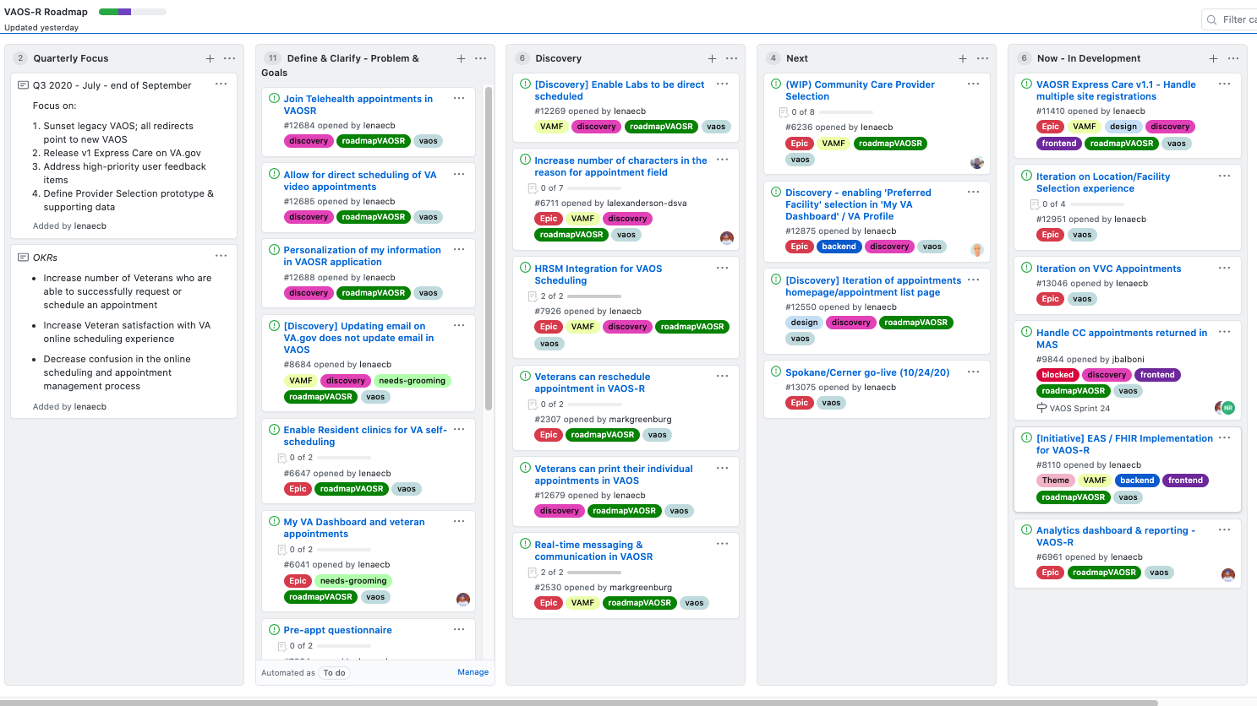
Roadmap & Backlog
https://github.com/department-of-veterans-affairs/va.gov-team/projects/13

Slide 13
Apothesource/BE Team

Slide 14
Recent Discussions & Decisions
Prioritize VA.gov/VAOS Functionality (over FHIR Compatibility)
Develop new VAOS interface supporting VistA, CC, and Cerner appointments
Cerner Patient/Provider Relationship Management
"…a Veteran can self-schedule with any provider who is delivering care in the type of care they are selecting (e.g. Primary Care) as long as they had an encounter with this provider in the last 12 months."
VistA Appointment Requests / VSE GUI
VIA/VistA appointment requests are not possible short-term
Possible VSE GUI / VA Mobile integration to support managing VVC/Telehealth and VAOS appointment requests

Slide 15
VAOS Milestone 1 (Time to Market/TtM)
Primary Changes:
No EAS/FHIR interface initially
Still provides a (different) potential path to FHIR
Mobile Appointment Service (MASv2) supports full management (read/write) for CC and VistA appointments
Replaces VAOS»VSS interface
VAOS service manages Veteran- and site-specific scheduling rules
Appointment Request Service (ARS) manages VAOS, Express Care appointment requests
Requests serviced through VSE GUI

Slide 16
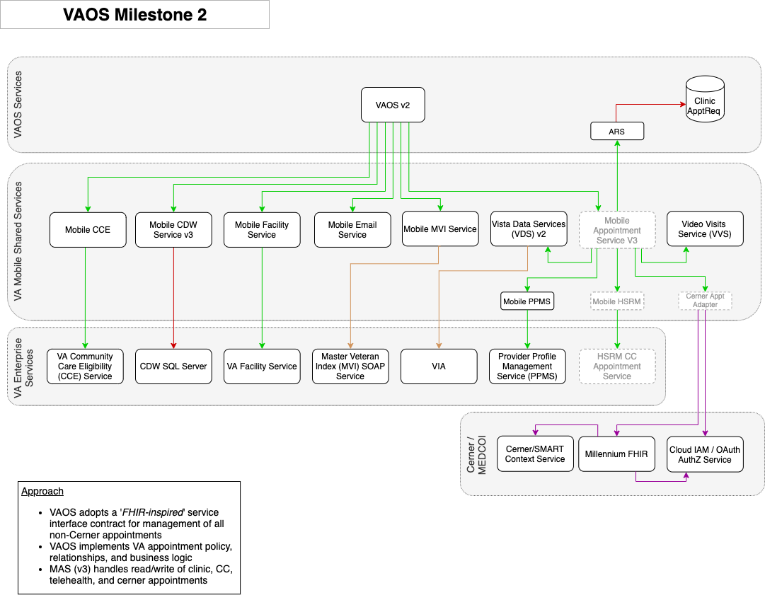
VAOS Milestone 2 (Time to Market/TtM)
Primary Changes:
Mobile Appointment Service (MASv3) supports full management (read/write) for Cerner, CC, and VistA appointments

Slide 17
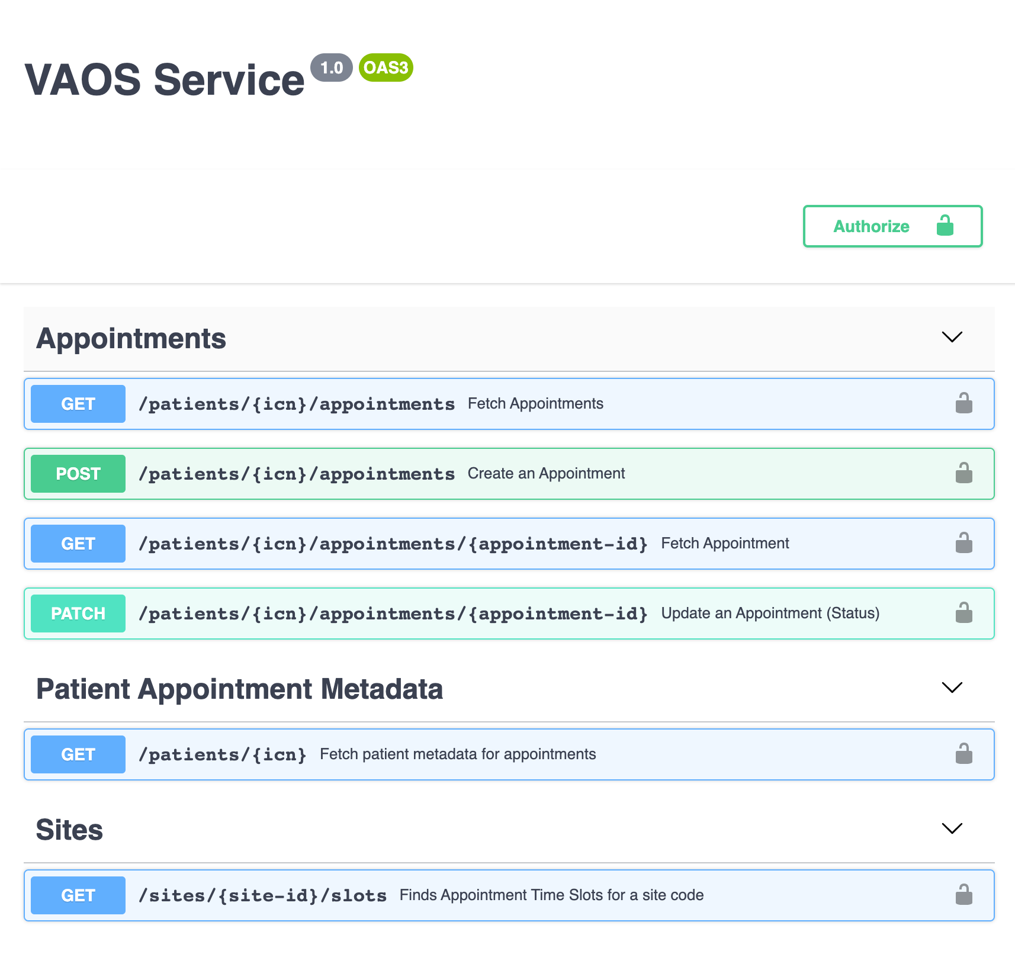
VAOS v1 Streamlined Interface
*Draft Interface Definition*
Simplified appointment-centric interface
Supports VistA/Clinic and CC Appointments
"FHIR-like" interface
Path to supporting Cerner appointments
Moves facility scheduling information and policy to Mobile Facility Service (MFS)
Delegates system-specific appointment management logic to Mobile Appointment Service (MAS)

Slide 18
Recent Updates
VAOS
VAR-Resources: Send emails to veterans acknowledging the submission of an Express Care Request (VAOSR-837)
VAR Resources: Update to JSP3 (VAOSR-896)
VAR Resources: Request limits are not enforced for express care or regular appointment requests (bug) (VAOSR-1025)
VAR Resources: Emails for Escalated not being sent on any of the resolved or cancel triggers (bug) (VAOSR-1055)
HSRM: Continued integration testing (VAOSR-897)
EAS: Federate HealthcareService requests to VSP (VAOSR-988)
EAS: Federate Slot requests to VSP (VAOSR-989)
MFS: Add new endpoint for fetching all types of care (VAOSR-1069)
MAS: Add the division name to the logical appointment model (requested by MHV) (VAOSR-1050)
MAS: Filter appointments for clinics beginning with ZZ- or ending with -X (VAOSR-1066)
MAS: Add additional error logging for VVS failures (VAOSR-1079)
Build Tooling
Create troubleshooting guide for Helm (VAOSR-1014)
Tech Debt:
VAOSR-1043: Remove SM CC Booked Appointments Repository
VAOSR-1041: Remove video-visit-lib dependency
VAOSR-1040: Audit OIS findings from 4.22 code review

Slide 19
Critical updates, action items, decisions, & questions

Slide 20
Critical updates
Express Care is targeted for September 23 go-live in Wilmington NC

Slide 21
Action Items, Questions, & Decisions
(#9844) To show or not to show all community care appointments in VistA: Potential that Community Care appointments can be created outside of the VAOS workflow and written to VistA directly. VAOS should account for these appointments because a Veteran needs to know they have been scheduled with their community provider. Potential for showing duplicate appts. - HSRM interface is the key to de-duplication going forward. - Dr. Greenstone would like to display these cc appts consistent with MHV, pending that it does not introduce duplicates. - Is there a potential to mitigate by not having MHV show a separate view of appointments and instead fully point to VA.gov?
Notes:
[4:30 PM] Case, Lynne M. (FEi Systems)is that because you are not using mobile-appintment-service?
[4:30 PM] Case, Lynne M. (FEi Systems)MAS is supposed to de-duplicate appointments
[4:30 PM] Jeff Balboni (Guest)The booked CC appointments that VAOS currently shows are not in MAS
[4:31 PM] Michael Ramirez (Guest)Because the frontend is calling to retrieve the booked CC appointments separately, I assume?
Yeah
[4:32 PM] Case, Lynne M. (FEi Systems)right, but the goal was for MHV and VA.gov to both pull from MAS so they get the same list
[4:32 PM] Case, Lynne M. (FEi Systems)so suggest if there are new rules, we get MAS updated
(1 liked)

Slide 22
Action Items, Questions, & Decisions
Mike R. & Steve Eaton to connect on direction re: appointment request service.
Steve to connect with Lynne to offer clarity.
Lenae: How can we support you, Apothesource? Mike: We will send something to you for feedback.
Notes:
[4:30 PM] Case, Lynne M. (FEi Systems)is that because you are not using mobile-appintment-service?
[4:30 PM] Case, Lynne M. (FEi Systems)MAS is supposed to de-duplicate appointments
[4:30 PM] Jeff Balboni (Guest)The booked CC appointments that VAOS currently shows are not in MAS
[4:31 PM] Michael Ramirez (Guest)Because the frontend is calling to retrieve the booked CC appointments separately, I assume?
Yeah
[4:32 PM] Case, Lynne M. (FEi Systems)right, but the goal was for MHV and VA.gov to both pull from MAS so they get the same list
[4:32 PM] Case, Lynne M. (FEi Systems)so suggest if there are new rules, we get MAS updated
(1 liked)

